Slide 1

Database Management Systems UNIT-IV

Slide 2
TABLE OF CONTENT
RELATIONAL ALGEBRA
RELATIONAL CALCULUS
TUPLE RELATIONAL CALCULUS
DOMAIN RELATIONAL CALCULUS
PITFALLS IN RELATIONAL DATABASE
DECOMPOSING BAD SCHEMA
FUNCTIONAL DEPENDENCY
DEFINITION
TRIVIAL, NON TRIVIAL FD
CLOSURE OF FD SET
CLOSURE OF ATTRIBUTES
IRREDUCIBLE SET OF FD/Minimal Cover
Decomposing using FD
Dependency preservation
NORMALIZATION
ANAMOLIES
1NF
2NF
3NF
BCNF
Multi- valued dependency,4NF
Join dependency and 5 NF

Slide 3
INTRODUCTION
Procedural versus non-procedural, or declarative
“Pure” languages:
Relational algebra
Tuple relational calculus
Domain relational calculus
A procedural language consisting of a set of operations that take one or two relations as input and produce a new relation as their result.
Six basic operators
select: σ
project: ∏
union: ∪
set difference: –
Cartesian product: x
rename: ρ

Slide 4

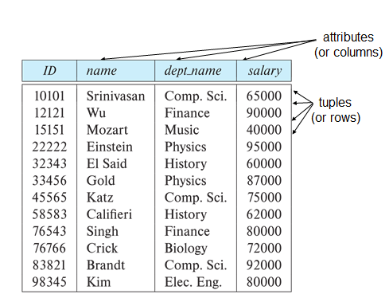
RELATIONAL ALGEBRA
Instructor Table Department Table

Slide 5
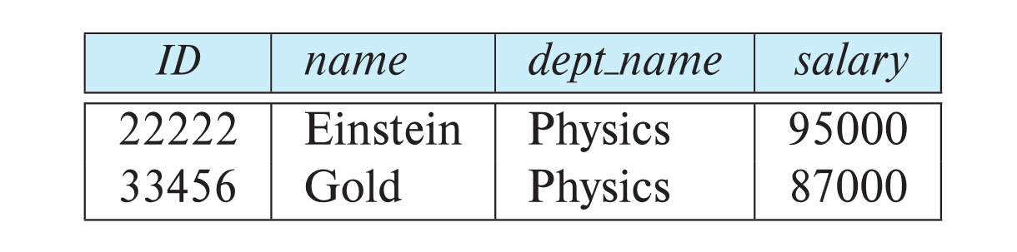
SELECT
The select operation selects tuples that satisfy a given predicate.
Notation: σ _{p} (r)
p is called the selection predicate
Example: select those tuples of the instructor relation where the instructor is in the “Physics” department.
Query
σ _{dept_name=“Physics”} (instructor)

Slide 6
SELECT
We allow comparisons using
=, ≠, >, ≥. <. ≤
in the selection predicate.
We can combine several predicates into a larger predicate by using the connectives:
∧ (and), ∨ (or), ¬ (not)
Example: Find the instructors in Physics with a salary greater $90,000, we write:
σ _{dept_name=“Physics”} ∧ _{salary >} _{90,000} (instructor)
The select predicate may include comparisons between two attributes.
Example, find all departments whose name is the same as their building name:
σ _{dept_name=building} (department)

Slide 7
PROJECT
A unary operation that returns its argument relation, with certain attributes left out.
Notation:
∏ _{A1,A2,A3 ….Ak} (r)
where A₁, A₂, …, A_{k} are attribute names and r is a relation name.
The result is defined as the relation of k columns obtained by erasing the columns that are not listed
Duplicate rows removed from result, since relations are sets

Slide 8
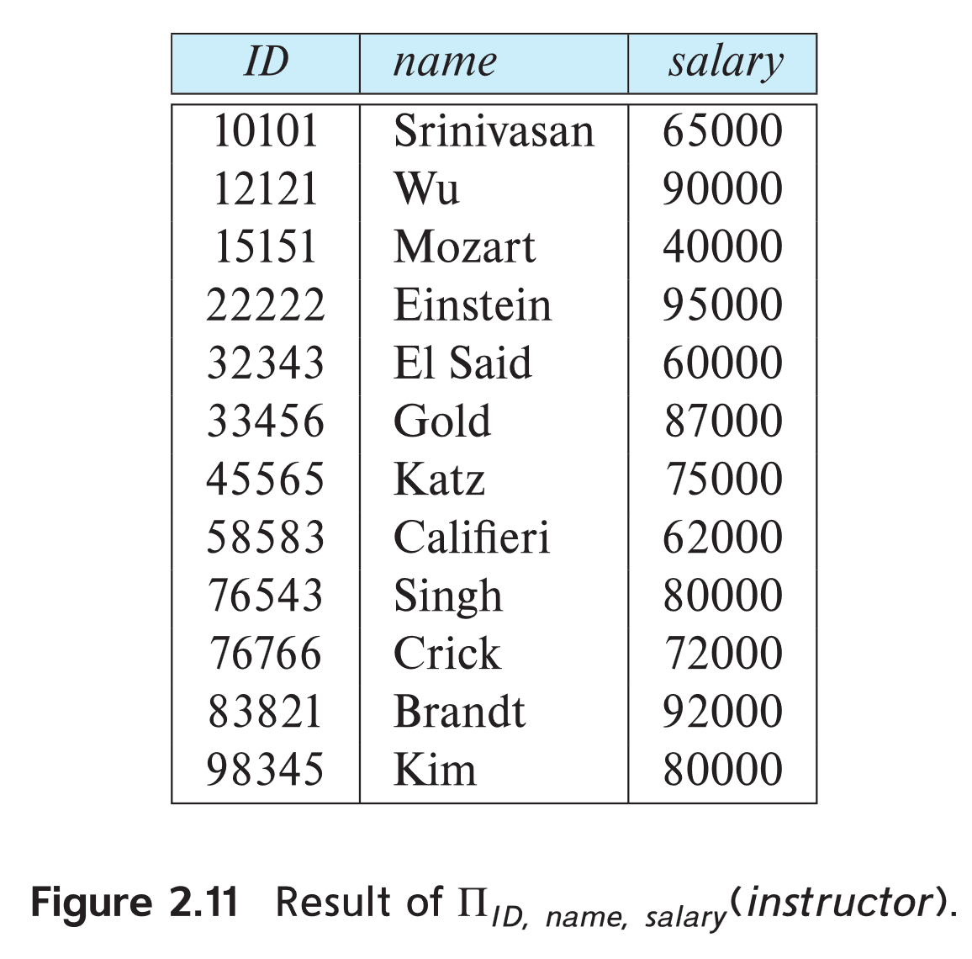
PROJECT
Eliminate the dept_name attribute of instructor
Query: ∏_{ID, name, salary} (instructor)

Slide 9
PROJECT
Find the names of all instructors in the Physics department.
∏_{name}(σ _{dept_name} _{=“Physics”} (instructor))

Slide 10
CARTESIAN PRODUCT
The Cartesian-product operation (denoted by X) allows us to combine information from any two relations.
Example: the Cartesian product of the relations instructor and teaches is written as:
instructor X teaches
Since the instructor ID appears in both relations we distinguish between these attribute by attaching to the attribute the name of the relation from which the attribute originally came.
instructor.ID
teaches.ID

Slide 11
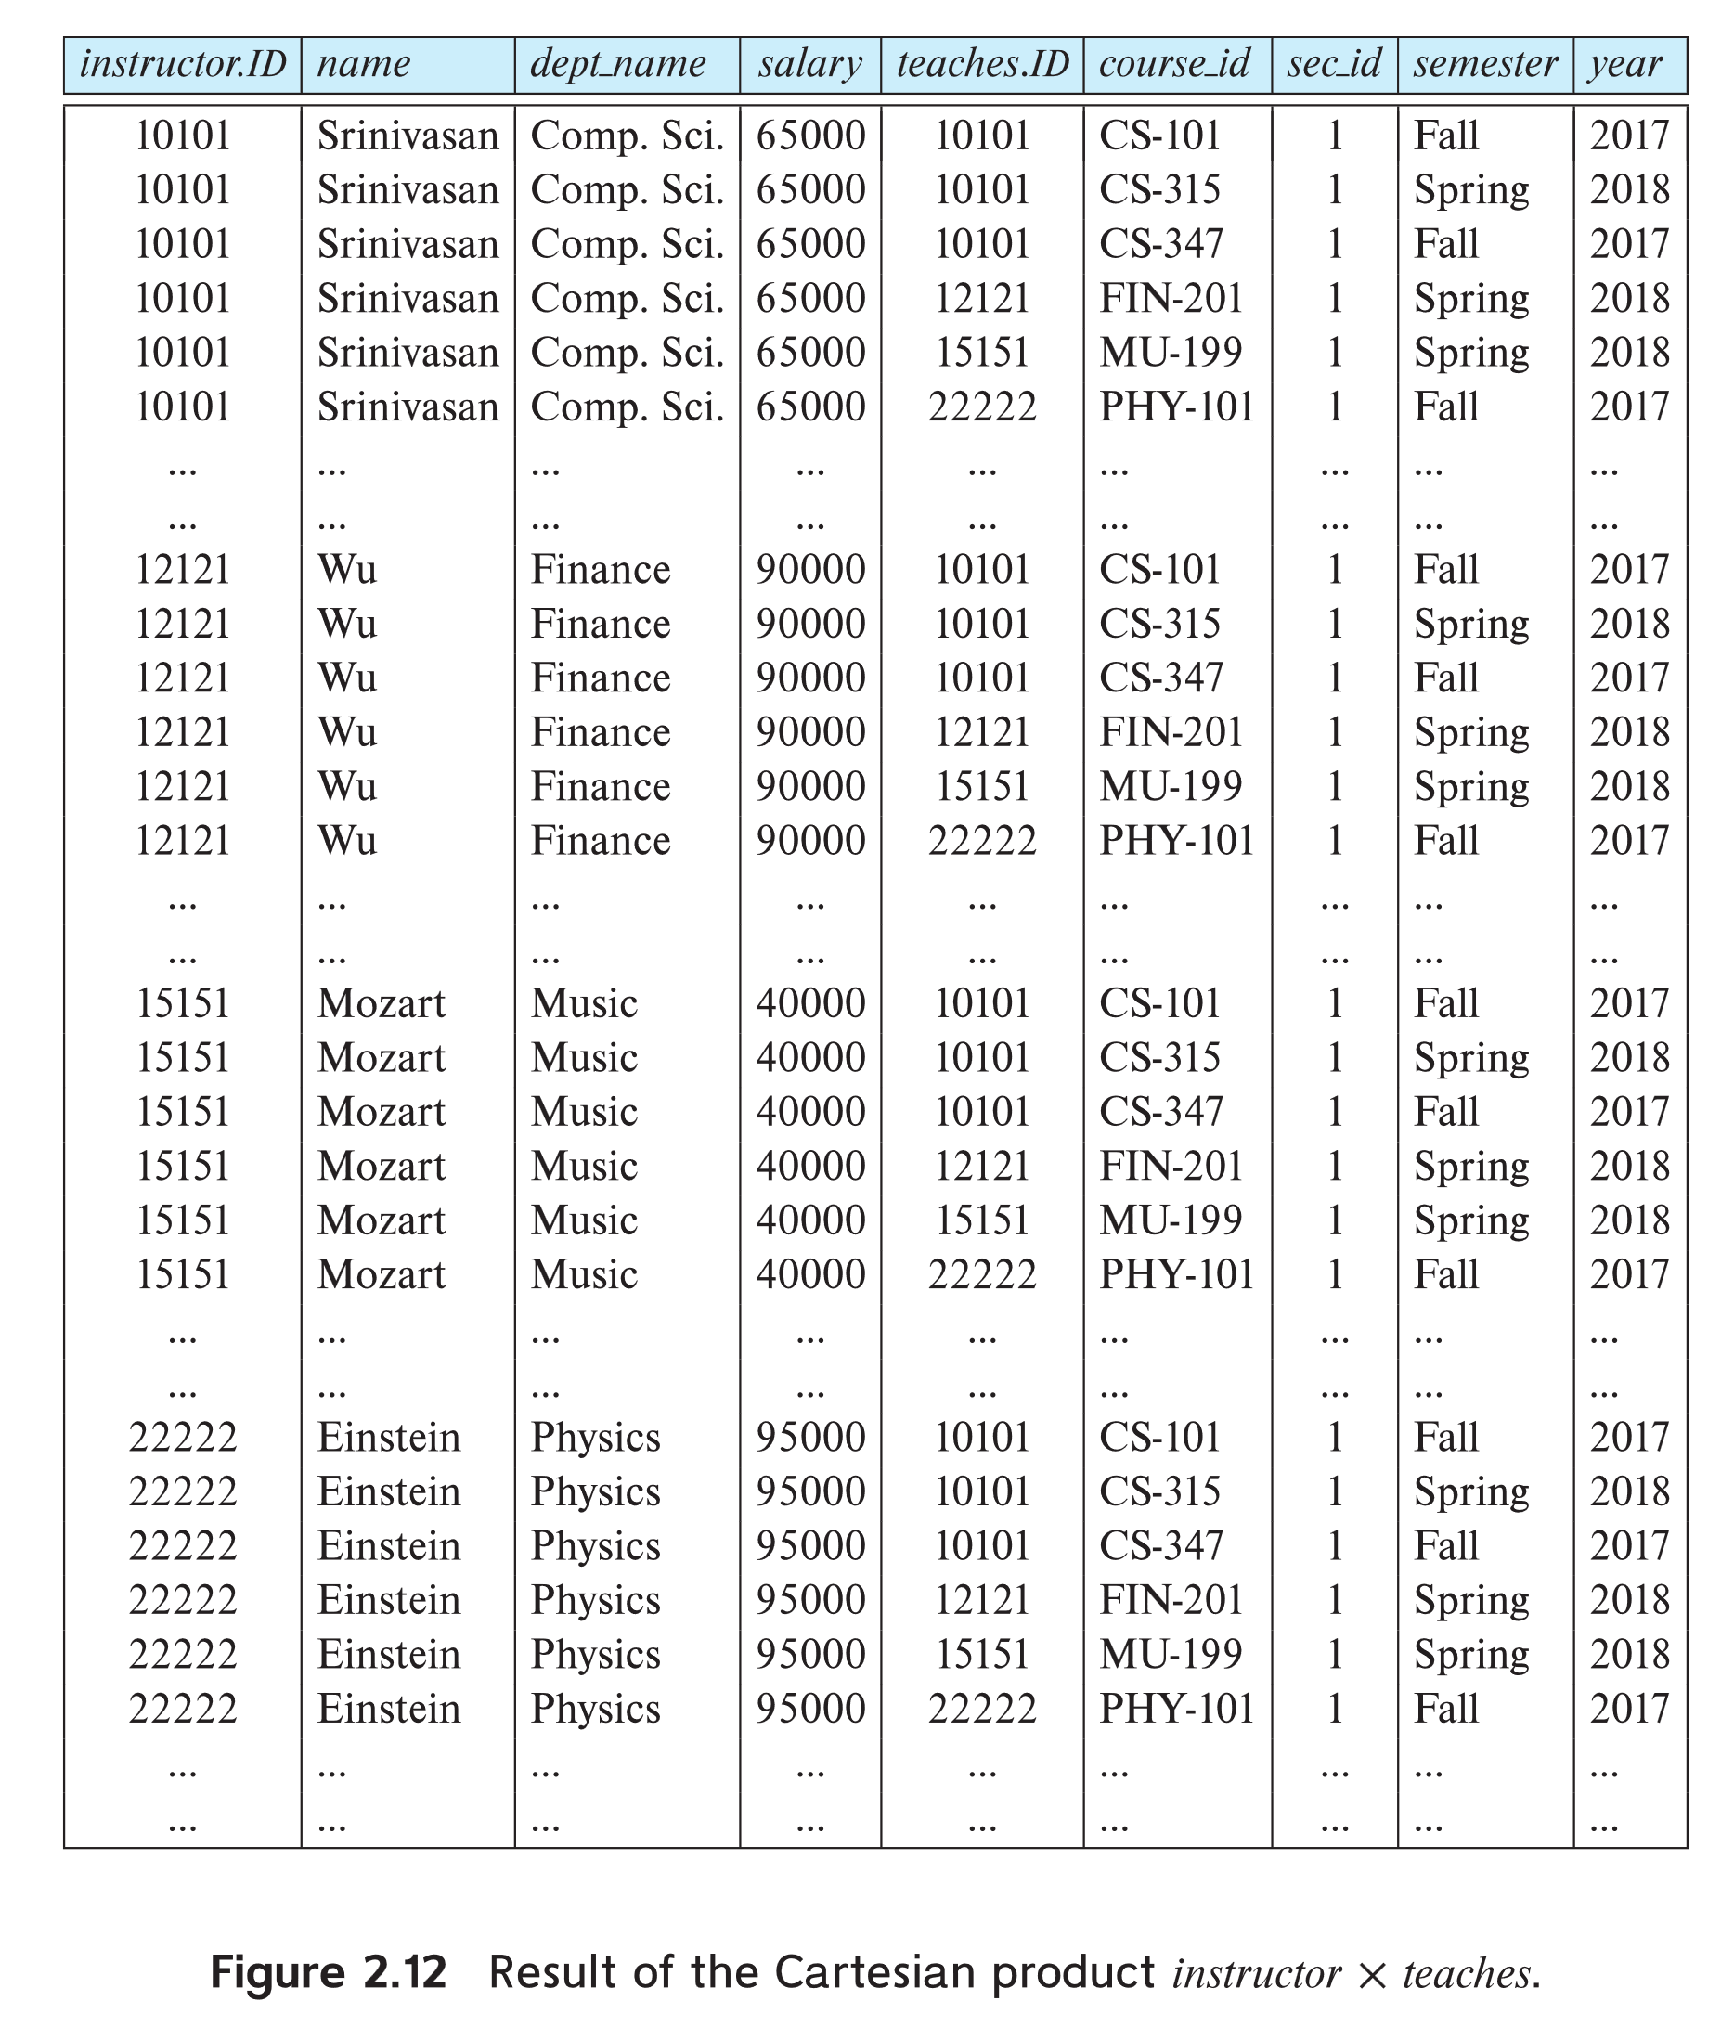
CARTESIAN RESULT

Slide 12
CARTESIAN PRODUCT
The Cartesian-Product
instructor X teaches
associates every tuple of instructor with every tuple of teaches.
Most of the resulting rows have information about instructors who did NOT teach a particular course.
To get only those tuples of “instructor X teaches “ that pertain to instructors and the courses that they taught, we write:
σ _{instructor.id = teaches.id} (instructor x teaches ))

Slide 13
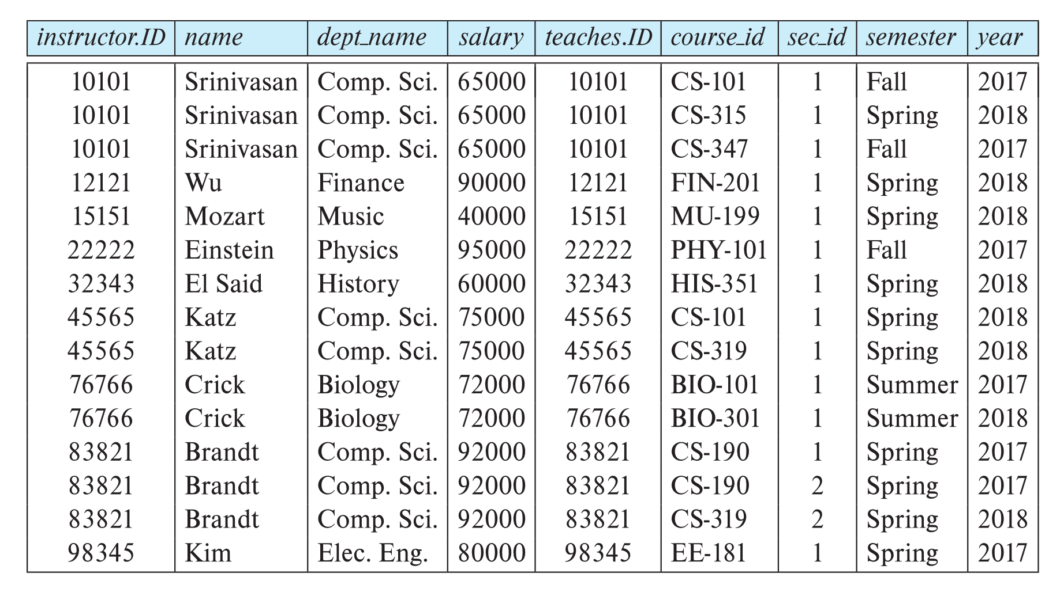
The table corresponding to:
σ _{instructor.id = teaches.id} (instructor x teaches))

Slide 14
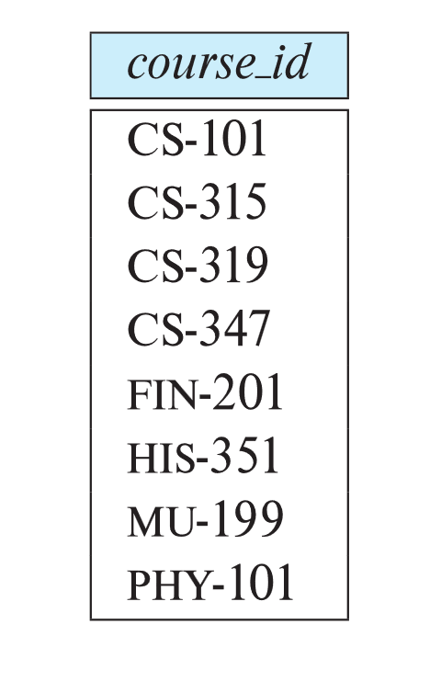
UNION
The union operation allows us to combine two relations
Notation: r ∪ s
For r ∪ s to be valid.
1. r, s must have the same arity (same number of attributes)
2. The attribute domains must be compatible (example: 2nd
column of r deals with the same type of values as does the
2nd column of s)
To find all courses taught in the Fall 2017 semester, or in the Spring 2018 semester, or in both ∏_{course_id} (σ _{semester=“Fall” Λ year=2017} (section)) ∪ ∏_{course_id} (σ _{semester=“Spring” Λ year=2018} (section))

Slide 15

INTERSECTION
The set-intersection operation allows us to find tuples that are in both the input relations.
Notation: r ∩ s
Assume:
r, s have the same arity
attributes of r and s are compatible
Example: Find the set of all courses taught in both the Fall 2017 and the Spring 2018 semesters.
∏_{course_id} (σ _{semester=“Fall” Λ year=2017} (section)) ∩ ∏_{course_id} (σ _{semester=“Spring” Λ year=2018} (section))

Slide 16

SET DIFFERENCE
The set-difference operation allows us to find tuples that are in one relation but are not in another.
Notation r – s
Set differences must be taken between compatible relations.
r and s must have the same arity
attribute domains of r and s must be compatible
Example: to find all courses taught in the Fall 2017 semester, but not in the Spring 2018 semester ∏_{course_id} (σ _{semester=“Fall” Λ year=2017} (section)) − ∏_{course_id} (σ _{semester=“Spring” Λ year=2018} (section))

Slide 17
ASSIGNMENT
It is convenient at times to write a relational-algebra expression by assigning parts of it to temporary relation variables.
The assignment operation is denoted by ← and works like assignment in a programming language.
Find all instructor in the “Physics” and Music department. Physics ← σ _{dept_name=“Physics”} (instructor)
Music ← σ _{dept_name=“Music”} (instructor)
Physics ∪ Music

Slide 18
RENAME
The results of relational-algebra expressions do not have a name that we can use to refer to them. The rename operator, ρ , is provided for that purpose
The expression:
ρ_{x} (E)
returns the result of expression E under the name x
Another form of the rename operation:
ρ_{x(A1,A2, .. An)} (E)

Slide 19
INTRODUCTION
Procedural versus non-procedural, or declarative
“Pure” languages:
Relational algebra
Tuple relational calculus
Domain relational calculus

Slide 20
TUPLE RELATIONAL CALCULUS
A nonprocedural query language, where each query is of the form
{t | P (t ) }
It is the set of all tuples t such that predicate P is true for t
t is a tuple variable
t [A ] denotes the value of tuple t on attribute A
t ∈ r denotes that tuple t is in relation r
P is a formula similar to that of the predicate calculus

Slide 21
Symbols
Set of attributes and constants
Set of comparison operators: (e.g., <, ≤, =, ≠, >, ≥)
Set of connectives: and (∧), or (v)‚ not (¬)
Implication (⇒): x ⇒ y, if x if true, then y is true
x ⇒ y ≡ ¬x v y
Set of quantifiers:
∃ t ∈ r (Q (t )) ≡ ”there exists” a tuple in t in relation r such that predicate Q (t ) is true
∀t ∈ r (Q (t )) ≡ Q is true “for all” tuples t in relation r

Slide 22
Examples
Find the ID, name, dept_name, salary for instructors whose salary is greater than $80,000
{t | t ∈ instructor ∧ t [salary ] > 80000}
Only the ID attribute value
{t | ∃ s ∈ instructor (t [ID ] = s [ID ] ∧ s [salary ] > 80000)}

Slide 23
Examples
Find the names of all instructors whose department is in the Watson building
Find the set of all courses taught in the Fall 2009 semester, or in the Spring 2010 semester, or both
{t | ∃s ∈ instructor (t [name ] = s [name ] ∧ ∃u ∈ department (u [dept_name ] = s[dept_name] “ ∧ u [building] = “Watson” ))}
{t | ∃s ∈ section (t [course_id ] = s [course_id ] ∧ s [semester] = “Fall” ∧ s [year] = 2009 v ∃u ∈ section (t [course_id ] = u [course_id ] ∧ u [semester] = “Spring” ∧ u [year] = 2010 )}

Slide 24
Pitfalls in Relational Database

Slide 25
Introduction
Relational databases are widely used in modern software applications for storing and managing data.
However, designing a good schema that represents the data accurately and efficiently is a challenging task.
In this presentation, we will explore the pitfalls in relational database design, and discuss how to decompose a bad schema and understand functional dependencies to improve it.

Slide 26
Pitfalls in Relational Database Design
1.1 Redundancy:
Storing the same data in multiple places can lead to inconsistencies and inefficiencies.
1.2 Inconsistency:
Data inconsistencies can occur when different parts of the database hold different versions of the same data.
1.3 Inefficiency:
Poor database design can result in slower query performance and increased storage requirements.
1.4 Complexity:
A complex database schema can be difficult to understand and maintain, leading to errors and inefficiencies.

Slide 27
Decomposing a Bad Schema
What is a bad schema?
A bad schema is a database schema that suffers from common design problems that can lead to issues such as data redundancy, inconsistency, and inefficiency.
Some common examples of bad schema design include tables with duplicate data, tables with many null values, and tables with inappropriate data types.
A bad schema can make it difficult to manage data, slow down queries, and cause data integrity issues.
Therefore, it is essential to design a good schema that accurately represents the data, is efficient, and minimizes redundancy and inconsistencies.

Slide 28
Decomposing a Bad Schema
Common problems in a bad schema:
Redundancy
Inconsistency
Inefficiency
Decomposition process:
Identify functional dependencies
Normalize the schema using normalization rules
Check for anomalies
Evaluate trade-offs

Slide 29
Functional Dependency
Functional dependency (FD) is a constraint that specifies the relationship between two attributes in a database table.
It states that one attribute (the dependent attribute) is functionally dependent on another attribute (the determinant attribute)
In other words, the value of the dependent attribute is uniquely determined by the value of the determinant attribute.
For example, in a database table that stores information about employees, the attribute "employee name" is functionally dependent on the attribute "employee ID", since each employee has a unique ID and a unique name.

Slide 30
Decomposition using Functional Dependency
Decomposition is the process of splitting a single database table into multiple tables to improve its design and eliminate redundancy.
In the context of functional dependencies, decomposition involves splitting a table into smaller tables that satisfy certain functional dependencies.

Slide 31
Dependency Preservation
Dependency preservation is the property that ensures that a decomposition of a table into smaller tables preserves the functional dependencies that existed in the original table.
In other words, if a functional dependency existed between two attributes in the original table, it should also exist in the smaller tables after decomposition.

Slide 32
Example
Suppose we have a database table called "employees" with the following attributes:
employees (employee_id, employee_name, department, salary)
Let's say that the following functional dependencies hold in this table:
employee_id -> employee_name, department, salary
department -> salary

Slide 33
Example
In other words, the employee ID uniquely determines the employee name, department, and salary, and the department uniquely determines the salary.
However, this table is not in a good design, because there is redundancy.
For example, if an employee changes departments, we would need to update multiple rows in the table to reflect this change.

Slide 34
Example
To eliminate this redundancy, we can decompose the table into two smaller tables, as follows:
employees1(employee_id, employee_name, department)
employees2(department, salary)

Slide 35
Example
In this new design, each table has fewer attributes and there is no redundancy.
However, we need to ensure that the functional dependencies still hold in the smaller tables.
We can check this by computing the closure of the functional dependencies in each table:
employees1 = {employee_id -> employee_name, department, salary}
employees2 = {department -> salary}

Slide 36
Example
The closure of each table includes the functional dependencies that hold in that table.
We can see that the functional dependencies that held in the original table are preserved in the decomposition, and so the decomposition satisfies dependency preservation.

Slide 37
Understanding Functional Dependencies
Definition:
Functional dependencies (FDs) are a fundamental concept in database design that describes the relationship between attributes or columns in a table.
In a relational database, an FD is a constraint that specifies that the value of one or more attributes uniquely determines the value of another attribute.
More specifically, let R be a relation schema with attributes A and B, where A and B are subsets of the set of attributes of R.
We say that A functionally determines B, denoted A → B, if for any two tuples t1 and t2 in R that agree on all attributes in A, they must also agree on all attributes in B.

Slide 38
Example:
Suppose we have a relation called "students" with attributes "student_id," "first_name," and "last_name."
If we know a student's "student_id," we can uniquely determine their "first_name" and "last_name."
Thus, we can say that "student_id" → ("first_name", "last_name") is a functional dependency in the "students" relation.
Functional dependencies are essential in database design because they help to ensure data integrity and prevent data anomalies.
They also aid in the normalization process by identifying redundant data and helping to eliminate it from the schema.

Slide 39
Trivial vs Non Trivial FD
The difference between trivial and non-trivial functional dependencies (FDs) lies in their implications for the data in a database.
A trivial FD is a functional dependency where the dependent attribute is already determined by the determinant attribute(s) and does not provide any new information.
In other words, a trivial FD always holds true and is not useful for data analysis or normalization.
For example, in a table with attributes A, B, and C, the FD A → A is trivial because it simply means that the value of attribute A determines itself, which is already a given.
Another example of a trivial FD is A, B → A, which states that knowing the values of A and B allows us to determine the value of A, which is again trivial.

Slide 40
Non Trivial FD
In contrast, a non-trivial FD is a functional dependency where the dependent attribute is not determined by the determinant attribute(s) alone, and thus provides new information about the data.
Non-trivial FDs are useful for analyzing and optimizing a database schema.
For example, in a table with attributes "employee_id," "employee_name," and "employee_department," the FD "employee_id" → "employee_name" is non-trivial because knowing the "employee_id" determines the "employee_name," and this information is not already given.
Similarly, in the same table,
the FD "employee_id" → "employee_department" is also non-trivial.

Slide 41
Closure of FD set
Given a set F of functional dependencies on a schema, we can prove that certain other functional dependencies also hold on the schema. We say that such functional dependencies are “logically implied” by F.
Let F be a set of functional dependencies. The closure of F, denoted by F+, is the set of all functional dependencies logically implied by F. Given F, we can compute F+ directly from the formal definition of functional dependency.

Slide 42
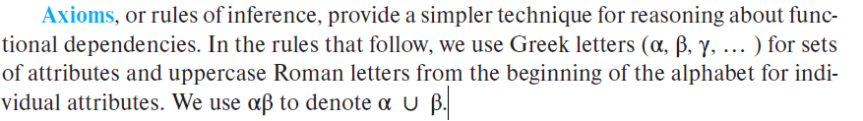
We can use the following three rules to find logically implied functional dependencies.
By applying these rules repeatedly, we can find all of F+, given F. This collection of rules is called Armstrong’s axioms in honor of the person who first proposed it.

Slide 43
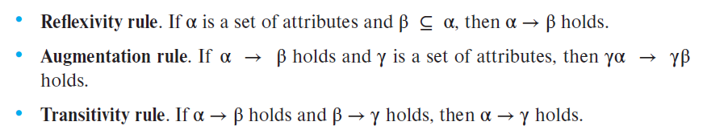
Armstrong’s axioms are sound, because they do not generate any incorrect functional dependencies. They are complete, because, for a given set F of functional dependencies, they allow us to generate all F+.

Slide 44
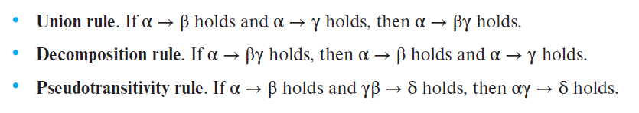
ADDITIONAL RULES

Slide 45
PROCEDURE TO COMPUTE F+
F+ = F
apply the reflexivity rule /* Generates all trivial dependencies */
repeat
for each functional dependency f in F+
apply the augmentation rule on f
add the resulting functional dependencies to F+
for each pair of functional dependencies f1 and f2 in F+
if f1 and f2 can be combined using transitivity
add the resulting functional dependency to F+
until F+ does not change any further

Slide 46
EXAMPLE
For relation R = (A, B, C, G, H, I) and the set F of functional dependencies {A → B, A → C, CG → H, CG → I , B → H}. Find out the closure of functional dependency.
A → H. Since A → B and B → H hold, we apply the transitivity rule.
CG → HI. Since CG → H and CG → I, the union rule implies that CG → HI.
AG → I. Since A → C and CG → I , the pseudo transitivity rule implies that AG → I holds.
Another way of finding that AG → I holds is as follows: We use the augmentation rule on A → C to infer AG → CG. Applying the transitivity rule to this dependency and CG → I, we infer AG → I .

Slide 47
Closure of attributes
Closure of an Attribute can be defined as a set of attributes that can be functionally determined from it.
Closure of a set of attributes X concerning F is the set X+ of all attributes that are functionally determined by X

Slide 48
Closure of an attribute:
The closure of attributes is a concept in database design that refers to the complete set of attributes that can be functionally determined by a given set of attributes in a relation.
The closure of attributes is important in database normalization because it helps to identify all the functional dependencies that hold in a relation and to eliminate redundancy and anomalies.
Formally, given a relation R and a set of attributes X in R, the closure of X, denoted by X+, is the set of all attributes in R that are functionally dependent on X. More specifically, X+ contains all the attributes that can be determined by X through a combination of the three axioms in Armstrong's Axioms: reflexivity, augmentation, and transitivity.

Slide 49
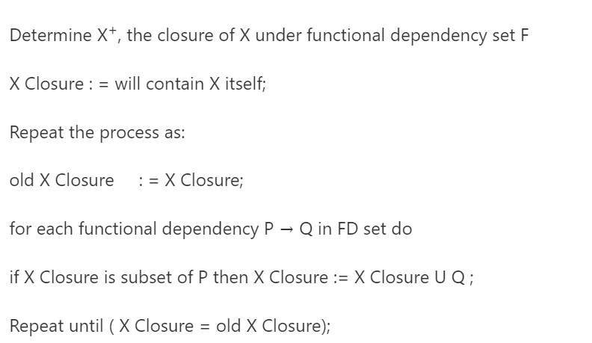
PSEUDOCODE TO FIND THE CLOSURE OF ATTRIBUTE

Slide 50
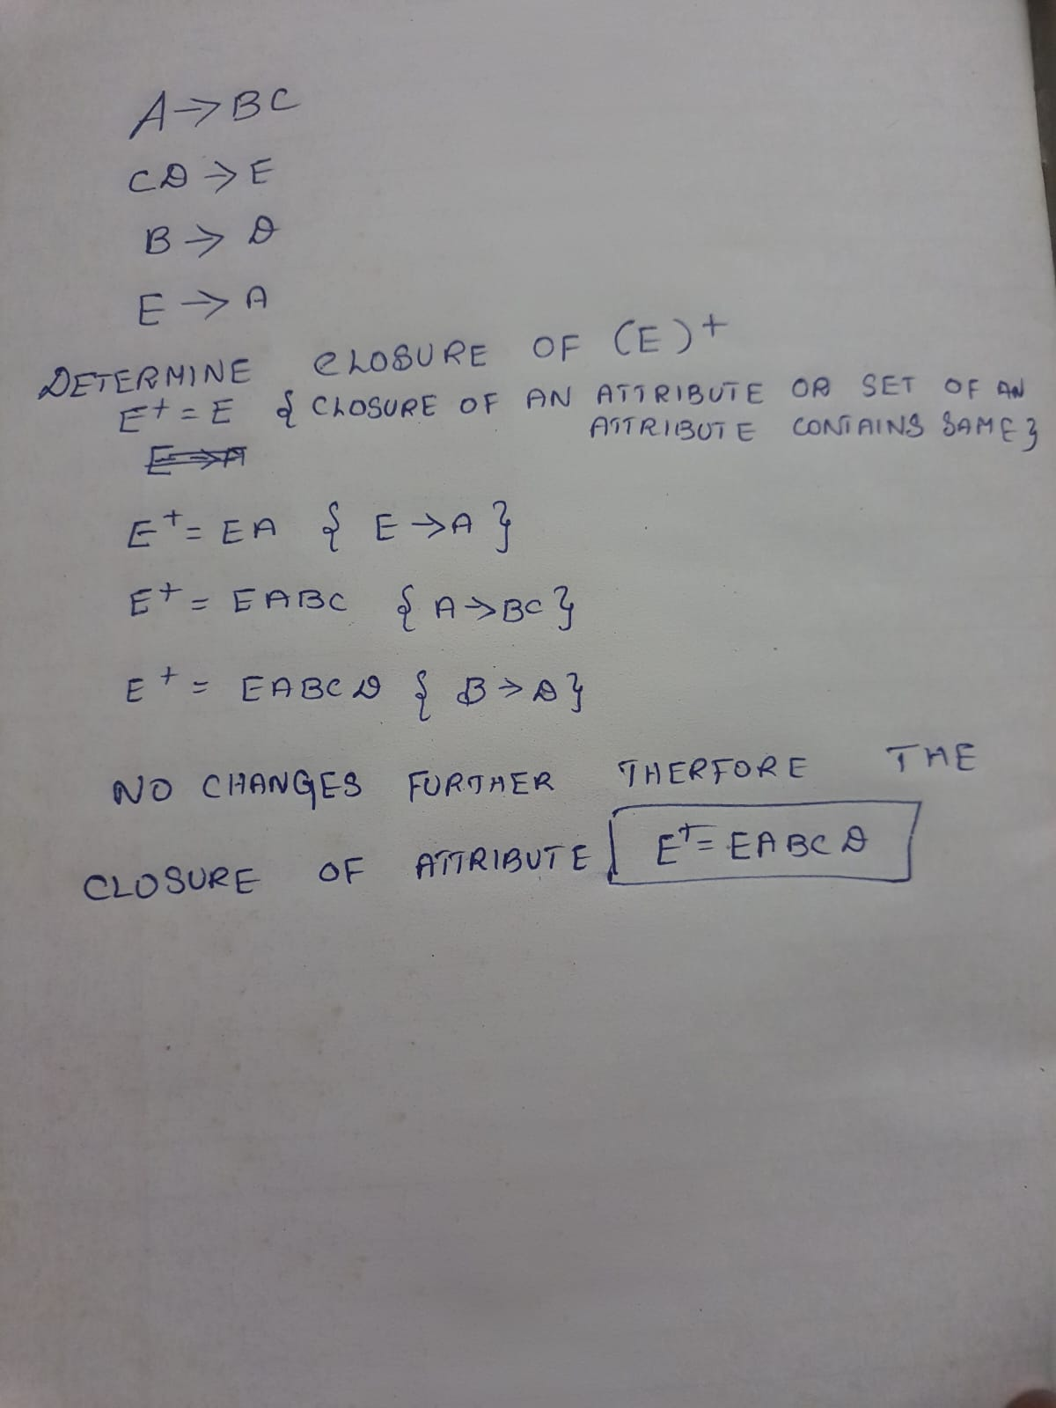
EXAMPLE 1[CLOSURE OF ATTRIBUTE]
Given Relational schema R(A,B,C,D,E) with the given FDs find the closure of an attribute ‘E’.

Slide 51
EXAMPLE 2[CLOSURE OF ATTRIBUTE]
For example, consider a relation with attributes A, B, C, and D and the following functional dependencies:
A → B
B → C
C → D
To find the closure of the attribute set {A}, the axioms are used to derive all the other attributes that are functionally dependent on {A}.
Using reflexivity, we know that A → A holds true, so we can augment {A} to get {A, B}. Then, using transitivity, we know that {A, B} → C holds true, so we can augment {A, B} to get {A, B, C}.
Finally, using transitivity again, we know that {A, B, C} → D holds true, so we can augment {A, B, C} to get the closure of {A}, which is {A, B, C, D}.
In this example, we have identified all the functional dependencies that hold in the relation and eliminated any redundancy or anomalies by normalizing the relation.

Slide 52
Irreducible a set of functional dependencies (or)Canonical Cover
A canonical cover or irreducible a set of functional dependencies FD is a simplified set of FD that has a similar closure as the original set FD.
Extraneous attributes
An attribute of an FD is said to be extraneous if we can remove it without changing the closure of the set of FD.

Slide 53
PROCEDURE TO COMPUTE CANONICAL COVER
Fc = F
repeat
Use the union rule to replace any dependencies in Fc of the form
α1 → β1 and α1 → β2 with α1 → β1 β2.
Find a functional dependency α → β in Fc with an extraneous
attribute either in α or in β.
/* Note: the test for extraneous attributes is done using Fc, not F */
If an extraneous attribute is found, delete it from α → β in Fc.
until (Fc does not change)

Slide 54
A canonical cover Fc for F is a set of dependencies such that F logically implies all dependencies in Fc, and Fc logically implies all dependencies in F. Furthermore, Fc must have the following properties:
No functional dependency in Fc contains an extraneous attribute.
Each left side of a functional dependency in Fc is unique. That is, there are no two
dependencies α1 → β1 and α2 → β2 in Fc such that α1 = α2

Slide 55
EXAMPLE:MINIMAL COVER
The following functional dependencies hold true for the relational scheme R ( W , X , Y , Z ) –
X → W
WZ → XY
Y → WXZ
Write the irreducible equivalent for this set of functional dependencies.

Slide 56
Step-01:
Write all the functional dependencies such that each contains exactly one attribute on its right side-
X → W
WZ → X
WZ → Y
Y → W
Y → X
Y → Z
Step-02:
Check the essentiality of each functional dependency one by one.
For X → W:
Considering X → W, (X)⁺ = { X , W }
Ignoring X → W, (X)⁺ = { X }

Slide 57
Now,
Clearly, the two results are different.
Thus, we conclude that X → W is essential and can not be eliminated.
For WZ → X:
Considering WZ → X, (WZ)⁺ = { W , X , Y , Z }
Ignoring WZ → X, (WZ)⁺ = { W , X , Y , Z }
Now,
Clearly, the two results are same.
Thus, we conclude that WZ → X is non-essential and can be eliminated.
Eliminating WZ → X, our set of functional dependencies reduces to-
X → W
WZ → Y
Y → W
Y → X
Y → Z
Now, we will consider this reduced set in further checks.

Slide 58
For WZ → Y:
Considering WZ → Y, (WZ)⁺ = { W , X , Y , Z }
Ignoring WZ → Y, (WZ)⁺ = { W , Z }
Now,
Clearly, the two results are different.
Thus, we conclude that WZ → Y is essential and can not be eliminated.
For Y → W:
Considering Y → W, (Y)⁺ = { W , X , Y , Z }
Ignoring Y → W, (Y)⁺ = { W , X , Y , Z }

Slide 59
Now,
Clearly, the two results are same.
Thus, we conclude that Y → W is non-essential and can be eliminated.
Eliminating Y → W, our set of functional dependencies reduces to-
X → W
WZ → Y
Y → X
Y → Z
For Y → X:
Considering Y → X, (Y)⁺ = { W , X , Y , Z }
Ignoring Y → X, (Y)⁺ = { Y , Z }

Slide 60
Now,
Clearly, the two results are different.
Thus, we conclude that Y → X is essential and can not be eliminated.
For Y → Z:
Considering Y → Z, (Y)⁺ = { W , X , Y , Z }
Ignoring Y → Z, (Y)⁺ = { W , X , Y }
Now,
Clearly, the two results are different.
Thus, we conclude that Y → Z is essential and can not be eliminated.
From here, our essential functional dependencies are-
X → W
WZ → Y
Y → X
Y → Z

Slide 61
Step-03:
Consider the functional dependencies having more than one attribute on their left side.
Check if their left side can be reduced.
In our set,
Only WZ → Y contains more than one attribute on its left side.
Considering WZ → Y, (WZ)⁺ = { W , X , Y , Z }
Now,
Consider all the possible subsets of WZ.
Check if the closure result of any subset matches to the closure result of WZ.
(W)⁺ = { W }
(Z)⁺ = { Z }
Clearly,
None of the subsets have the same closure result same as that of the entire left side.
Thus, we conclude that we can not write WZ → Y as W → Y or Z → Y.
Thus, set of functional dependencies obtained in step-02 is the canonical cover.
Finally, the canonical cover is X → W
WZ → Y
Y → X
Y → Z

Slide 62
Normalization
Database Normalization is the technique of organizing data into more than one table in the database.
It is a systematic approach of decomposing tables to eliminate data redundancy and undesirable characteristic like insertion, updation and deletion anomalies.
It is a multi-step process that puts data into tabular form, removing duplicated data from the relation tables.

Slide 63
Two Main Reasons
It eliminate redundancy data
It ensure data dependency makes sense.

Slide 64
Problem without Normalization
Without normalization it becomes difficult to handle and update database without facing data loss.
Insertion, updation and deletion anomalies are very frequent if the database is not normalized.

Slide 65
Anomalies
Insertion Anomaly: Insertion Anomaly refers to when one cannot insert a new tuple into a relationship due to lack of data.
Deletion Anomaly: The delete anomaly refers to the situation where the deletion of data results in the unintended loss of some other important data.
Updation Anomaly: The update anomaly is when an update of a single data value requires multiple rows of data to be updated.

Slide 66
S_id | S_name | S_address | Subject
401 | Adam | Noida | Biology
402 | Alex | Panipat | Maths
403 | Stuart | Jammu | Maths
404 | Adam | Noida | Physics
Updation Anomaly: To update address of student to occurs twice (or) more than twice in a table we have to update address column in all the rows else the data will come inconsistent.
Insertion Anomaly: Suppose for a student new admission, we have s_id, s_name, s_address of a student but the student has not opted for any subject then we have to insert null for the subject which leads to insertion anomalies.
Deletion Anomaly: If s_id = 401 has only one subject and temporarily drop it when we delete that row entire student record will be deleted along with it.

Slide 67
NORMAL FORMS
The term Normalization comes from the concept of normal form which describe how to organize the data in the database.
Normal Forms were developed around the concept of table based on relational database.

Slide 68
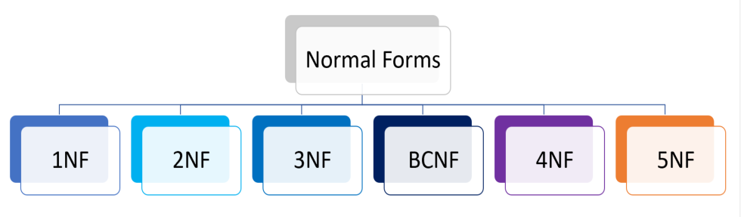
Types
1NF (First Normal Form)
2NF (Second Normal Form)
3NF (Third Normal Form)
BCNF (Boyce-Codd Normal Form)
4NF (Fourth Normal Form)
5NF (Fifth Normal Form)

Slide 69
UN-NORMALIZED FORM
If a table contains one or more repeating groups it is called Un-Normalized form.
Course | Content
Programming | C, Java, Python
Web | HTML, ASP, PHP

Slide 70
FIRST NORMAL FORM (1NF)
A relation is said to be in First Normal Form
If and only if all the attributes of relation are atomic (Single valued) in nature.
Must not contain any multi valued (or) composite attributes.
Course | Content
Programming | C, Java, Python
Web | HTML, ASP, PHP

Slide 71
This relation consists of multi-values. Hence it is not in first normal form.
The multi-values are eliminated and are written separately for each name (i.e.) multi-values are written atomic.
The table look like, after normalizing,
This 1NF allows data redundancy and there will be many column with same data in multiple rows but each row as a whole will be unique.
It is used in most small to medium application.
Course | Content
Programming | C
Programming | Java
Programming | Python
Web | HTML
Web | ASP
Web | PHP
Course | Content
Programming | C, Java, Python
Web | HTML, ASP, PHP

Slide 72
SECOND NORMAL FORM (2NF)
A relation is said to be in Second Normal Form,
If and only if it is already in First Normal Form.
There exist no Partial Dependency.
Partial Dependency:
It means that a non-prime attribute is functionally dependent on part of a prime attribute.
Functional Dependency:
All the non key attributes are fully functional depends on key attribute.

Slide 73
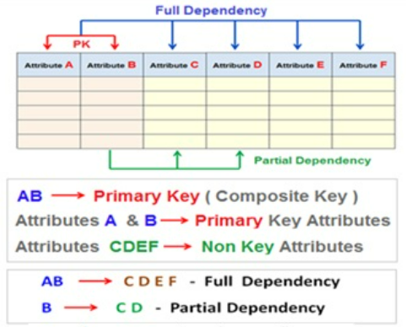

Slide 74
To eliminate Partial Dependency
Create a new relation for each primary key attributed that is a determinant in partial dependency.
Move non-key attributes that are depend on primary key attributes from old relation to new relation.

Slide 75
Emp_id | E_name | Month | Sales | B_id | B_name
E1 | AA | Jan | 1000 | B1 | SBI
E1 | AA | Feb | 1200 | B1 | SBI
E2 | BB | Jan | 2200 | B2 | UBI
E2 | BB | Feb | 2500 | B2 | UBI
E3 | CC | Jan | 1700 | B1 | SBI
E3 | CC | Feb | 1800 | B1 | SBI
In the example, Emp_id is a primary key.
All the non-prime attributes depends on the Emp_id.
But B_name depends on B_id which is not in 2NF.
So this table is in 1NF but not in 2NF.
After removing the position into another relation store the lesser amount of data in two relations without the loss of data.

Slide 76
Example Table
Emp_id | E_name | Month | Sales | B_id | B_name
E1 | AA | Jan | 1000 | B1 | SBI
E1 | AA | Feb | 1200 | B1 | SBI
E2 | BB | Jan | 2200 | B2 | UBI
E2 | BB | Feb | 2500 | B2 | UBI
E3 | CC | Jan | 1700 | B1 | SBI
E3 | CC | Feb | 1800 | B1 | SBI
Table 1
Table 2
Emp_id | E_name | Month | Sales | B_id
E1 | AA | Jan | 1000 | B1
E1 | AA | Feb | 1200 | B1
E2 | BB | Jan | 2200 | B2
E2 | BB | Feb | 2500 | B2
E3 | CC | Jan | 1700 | B1
E3 | CC | Feb | 1800 | B1
B_id | B_name
B1 | SBI
B2 | UBI

Slide 77
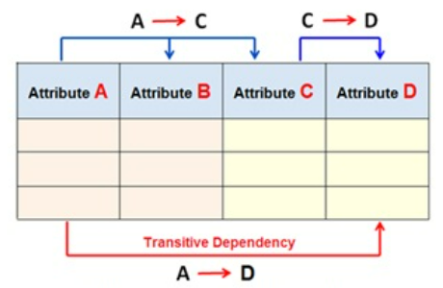
THIRD NORMAL FORM (3NF)
A relation is said to be in Third Normal Form if and only if,
It is already in Second Normal Form.
There exist no Transitive Dependency.

Slide 79
Transitive Dependency
A->B (B depends on A)
B->C
A->C
The derived dependency is called transitive dependency when such dependency becomes improbable (i.e.) non-prime attribute depends on another non-prime attribute.
Eg:
Rollno->marks
Marks->grade
Rollno->grade

Slide 80
To eliminate Transitive Dependency
For each non-key attribute that is determinant in relation, create a new relation that attribute becomes a primary key in new relation.
Move all of the attribute that are functionally dependent on attribute from old relation into new relation.
Leave the attribute (which serve as primary key in new relation) in old relation to serve as a foreign key.

Slide 81
S_id | S_name | City | Pincode
1 | Shiva | Chennai | 15
2 | Peter | Pondy | 17
3 | Meera | Villupuram | 20
4 | Rohan | Delhi | 01
5 | Shakthi | Bangalore | 18

Slide 82
Example Table
S_id | S_name | City | Pincode
1 | Shiva | Chennai | 15
2 | Peter | Pondy | 17
3 | Meera | Villupuram | 20
4 | Rohan | Delhi | 01
5 | Shakthi | Bangalore | 18
Table 1
Table 2
S_id | S_name | Pincode
1 | Shiva | 15
2 | Peter | 17
3 | Meera | 20
4 | Rohan | 01
5 | Shakthi | 18
Pincode | City
15 | Chennai
17 | Pondy
20 | Villupuram
01 | Delhi
18 | Bangalore

Slide 83
BCNF-BOYCE CODD NORMAL FORM
BCNF is the advance version of 3NF. It is stricter than 3NF.
A table is in BCNF if every functional dependency X → Y, X is the super key of the table.
For BCNF, the table should be in 3NF, and for every FD, LHS is super key

Slide 84
Consider a relation R with attributes (student, subject, teacher).
F: { (student, Teacher) -> subject (student, subject) -> Teacher Teacher -> subject}
Candidate keys are (student, teacher) and (student, subject).
The above relation is in 3NF [since there is no transitive dependency].
A relation R is in BCNF if for every non-trivial FD X->Y, X must be a key.
The above relation is not in BCNF, because in the FD (teacher->subject), teacher is not a key.
Decomposition for BCNF
Teacher-> subject violates BCNF [since teacher is not a candidate key].
If X->Y violates BCNF then divide R into R1(X, Y) and R2(R-Y).
So R is divided into two relations R1(Teacher, subject) and R2(student, Teacher).

Slide 85

Fourth Normal Form (4NF)
Functional dependencies can help us detect poor E-R design
multivalued dependency arises from one of the following sources:
• A many-to-many relationship set.
• A multivalued attribute of an entity set.
A relation schema (R) is in fourth normal form(4NF)with respect to a set D of functional and multivalued dependencies if, for all multivalued dependencies in D of the form A→→B, where A⊆R and B ⊆R, at least one of the following holds:
• A→→B is a trivial multivalued dependency.
• A is a super key for R.

Slide 86
4NF
A table is said to be in 4NF if the following conditions are met,
The table is in Boyce-Codd Normal Form (BCNF).
The table is not any having an independent multi-valued dependency.

Slide 87
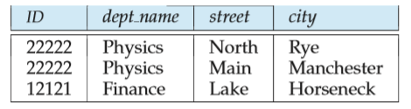

What is a Multivalued Dependency?
A full constraint between two sets of attributes in a relation.
Multivalued dependency would occur whenever two separate attributes in a given table happen to be independent of each other. And yet, both of these depend on another third attribute. The multivalued dependency contains at least two of the attributes dependent on the third attribute.
ID →→ street, city
ID→→dept name is a non-trivial multivalued dependency and ID is not a superkey for the schema.

Slide 88
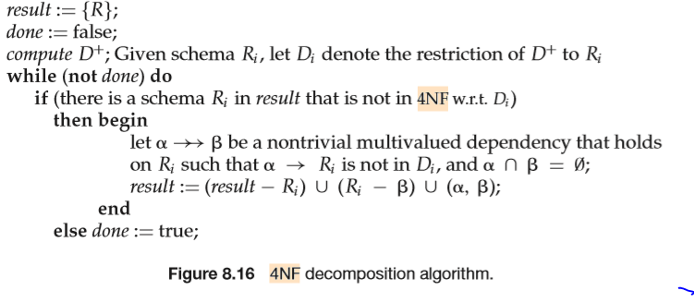
4NF DECOMPOSITION ALGORITHM

Slide 89

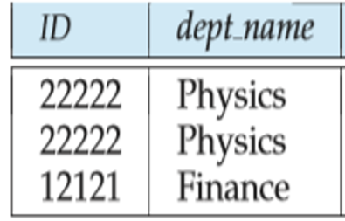
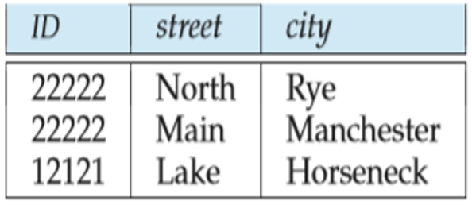
Lossless-join Decomposition
A decomposition of R into R1 and R2 is a lossless join if at least one of the following dependencies is in D+
And lossless if R1 U R2=D+
ID→→dept_name is a non-trivial multivalued dependency, and ID is not a superkey for the schema.
Following the algorithm,we replace it by two schemas:
r1 (ID, dept name) r2 (ID, street, city)

Slide 90
Join dependency and 5 NF
5NF is also called project join normal form(PJNF)
It is based on lossless join decomposition.
A relation is said to be in 5NF
if and only if it satisfies 4NF and no join dependency exists.
A relation is said to have join dependency if it can be recreated by joining multiple sub relations and each of these sub-relations has a subset of the attributes of the original relation.

Slide 91
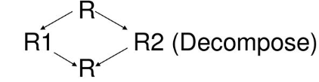
Condition for join dependency
Consider a relation R(P,Q,S) .
where R1 and R2 are the decompositions such that
R1 (P, Q) and R2 (Q, S)
Then R1 and R2 are a lossless decomposition of R if R can be obtained by joining R1 and R2.

Slide 92
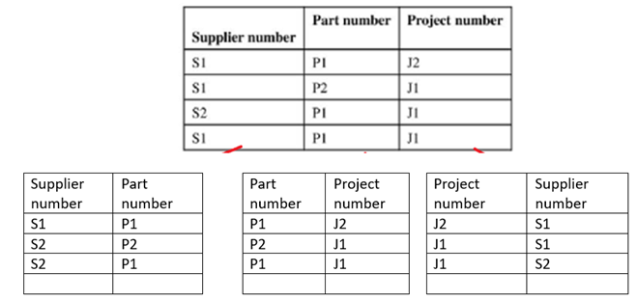
P1
P2
P3

Slide 93
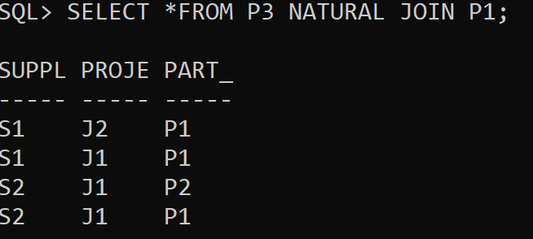
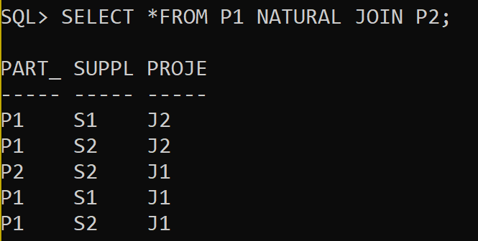
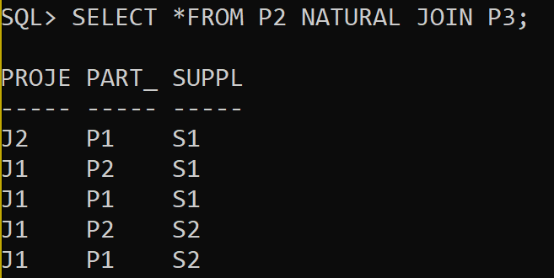
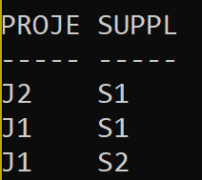
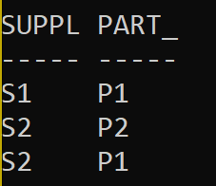
SO THE TABLE TO SATISFY 5NF IS PARTITIONED INTO P3 AND P1 since the natural join does not generate any additional rows

Slide 94
Normal Form
1NF A relation is in 1NF if it contains an atomic value.
2NF A relation will be in 2NF if it is in 1NF and all non-key attributes are fully functional dependent on the primary key.
3NF A relation will be in 3NF if it is in 2NF and no transition dependency exists.
BCNF A stronger definition of 3NF & on the left-hand side of the functional dependency there is a candidate key
4NF A relation will be in 4NF if it is in Boyce Codd's normal form and has no multi-valued dependency.
5NF A relation is in 5NF. If it is in 4NF and does not contain any join dependency, joining should be lossless.

Slide 95
Example 1:
In this example, we have to find the highest normalization form, and for that, we are given a relation R(A, B, C, D, E) with functional dependencies as follows: { BC->D, AC->BE, B->E }
As we can see, (AC)+={A, C, B, E, D} and also, none of its subsets can determine all the attributes of the relation. There is another point to be noted that A or C can’t be derived from any other attribute of the relation, and therefore, there is only one candidate key, {AC}.
Prime attributes in DBMS are always part of the candidate keys, and for this relation R, prime attributes are: {A, C} while non-prime attributes are: {B, E, D}.
Clearly, there is no multi-valued attribute in the relation R, and hence, it is at least in 1NF.
BC->D is in 2NF because BC is not a proper subset of the candidate key AC. AC->BE is also in 2NF because AC itself is a candidate key, and lastly, B->E is again in 2NF. For 2NF, there must not be any partial dependency present in the table, and hence, relation R here is in 2NF.
The relation R is not in 3NF because BC->D at the start is not in 3NF (BC is not a candidate key, and also, D is not a prime attribute). Hence, the relation R has 2NF as the highest normalization form.

Slide 96
THANK YOU

